Slide 1
E-Commerce Data Warehouse and Analysis
MET CS689 12-11-2022
Members: Sansit Kabi(U21105245)
Rishabh Singh(U28081858)

Slide 2








Agenda
Project background
Dataset source
ETL process
Schema
Lesson Learned

Slide 3


Project background
This is a Brazilian e-commerce public dataset of orders made at Olist Store. The dataset has information of 100k orders from 2016 to 2018 made at multiple marketplaces in Brazil. Its features allows viewing an order from multiple dimensions: from order status, price, payment and freight performance to customer location, product attributes and finally reviews written by customers.
The second data set is a marketing funnel dataset from sellers that filled-in requests of contact to sell their products on Olist Store. The dataset has information of 8k Marketing Qualified Leads (MQLs) that requested contact between Jun. 1st 2017 and Jun 1st 2018. They were randomly sampled from the total of MQLs. Its features allows viewing a sales process from multiple dimensions: lead category, catalog size, behaviour profile, etc. c
In this project, we will use transactional data to create a data warehouse and develop dashboard that answers our business questions.
Notes:
##This is real data, it has been anonymized and sampled from the original dataset.

Slide 4
Dataset source
Dataset:Sales Data--https://www.kaggle.com/datasets/olistbr/brazilian-ecommerce?datasetId=55151&sortBy=voteCount&select=olist_customers_dataset.csv
Marketing Data -- https://www.kaggle.com/datasets/olistbr/marketing-funnel-olist?select=olist_marketing_qualified_leads_dataset.csv
This dataset was generously provided by Olist, the largest department store in Brazilian marketplaces. Olist connects small businesses from all over Brazil to channels without hassle and with a single contract. Those merchants are able to sell their products through the Olist Store and ship them directly to the customers using Olist logistics partners.

Slide 5
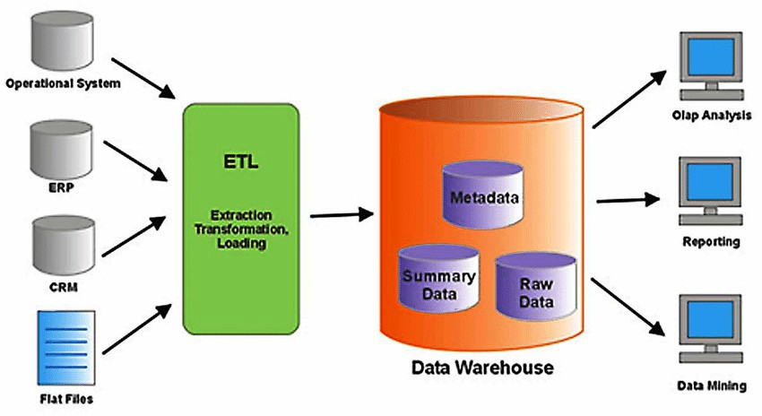
Data Warehouse Modeling

Slide 6
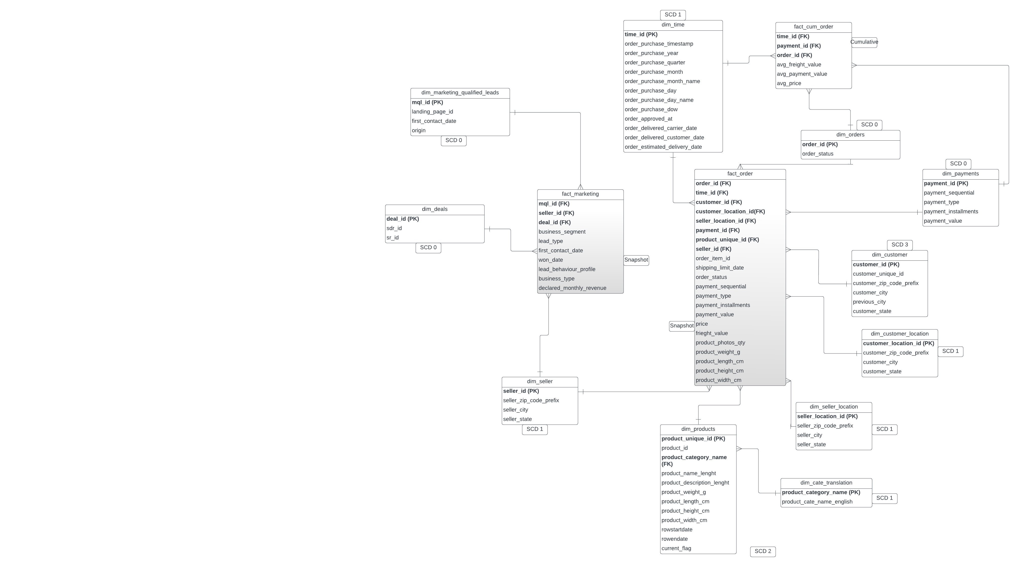
Schema

Slide 7
ETL Process
We are doing SCD (type 2) on column dim_products as it usually change relatively slow
We have 11 dimension tables, including a time dimension:
Marketing qualified leads.
Deals
Seller
Products
Category Translation
Time
Seller location
Customer location
Customer
Payments
Orders
We also have two fact tables i.e., fact_order and fact_marketing

Slide 8
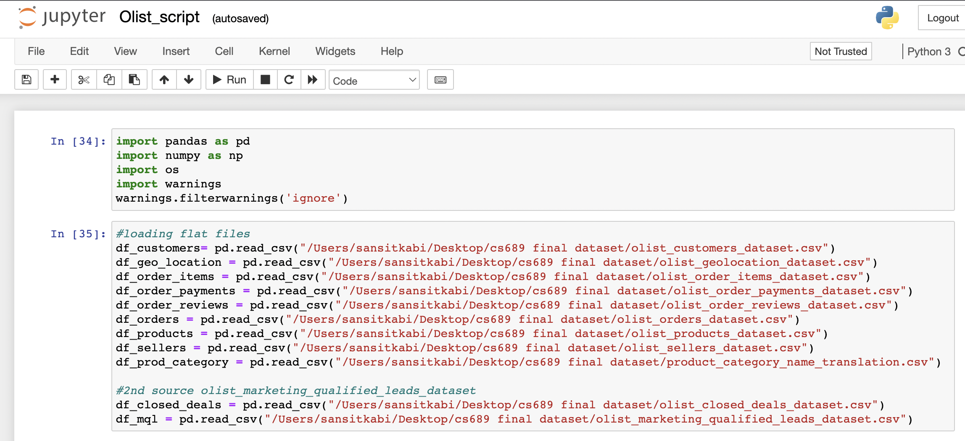
ETL cont.

Slide 9
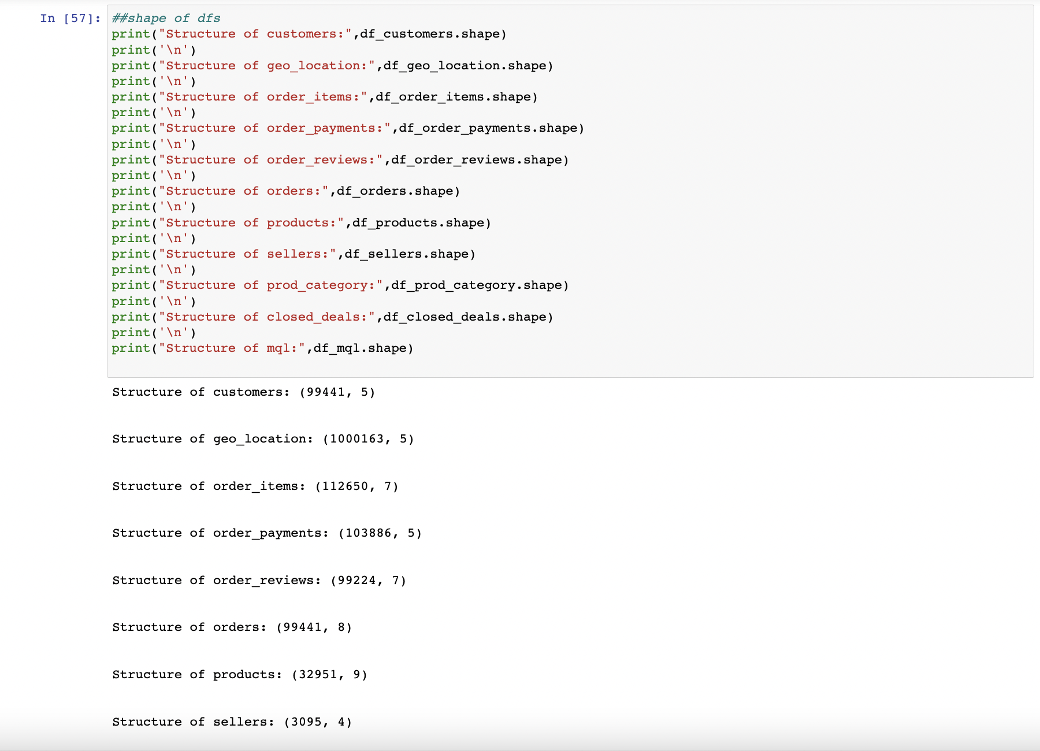
ETL cont.

Slide 10
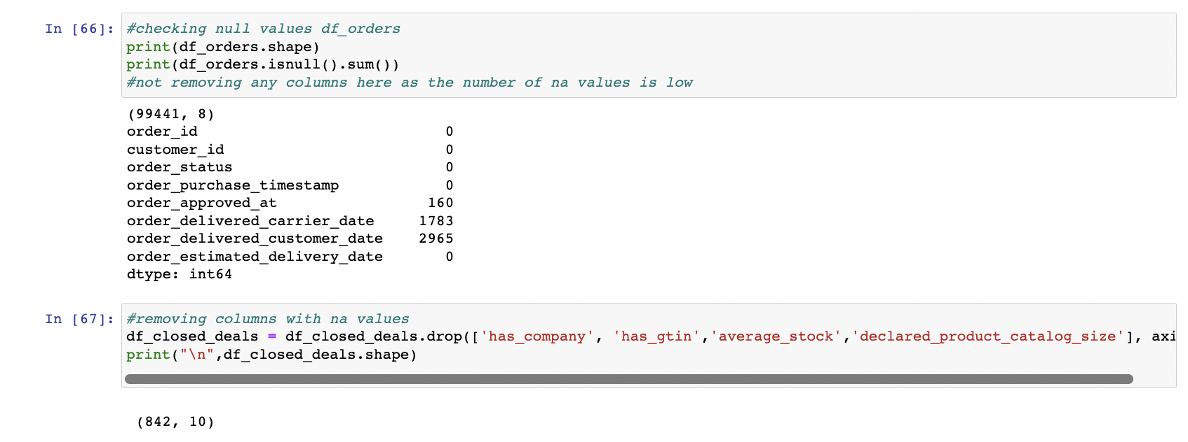
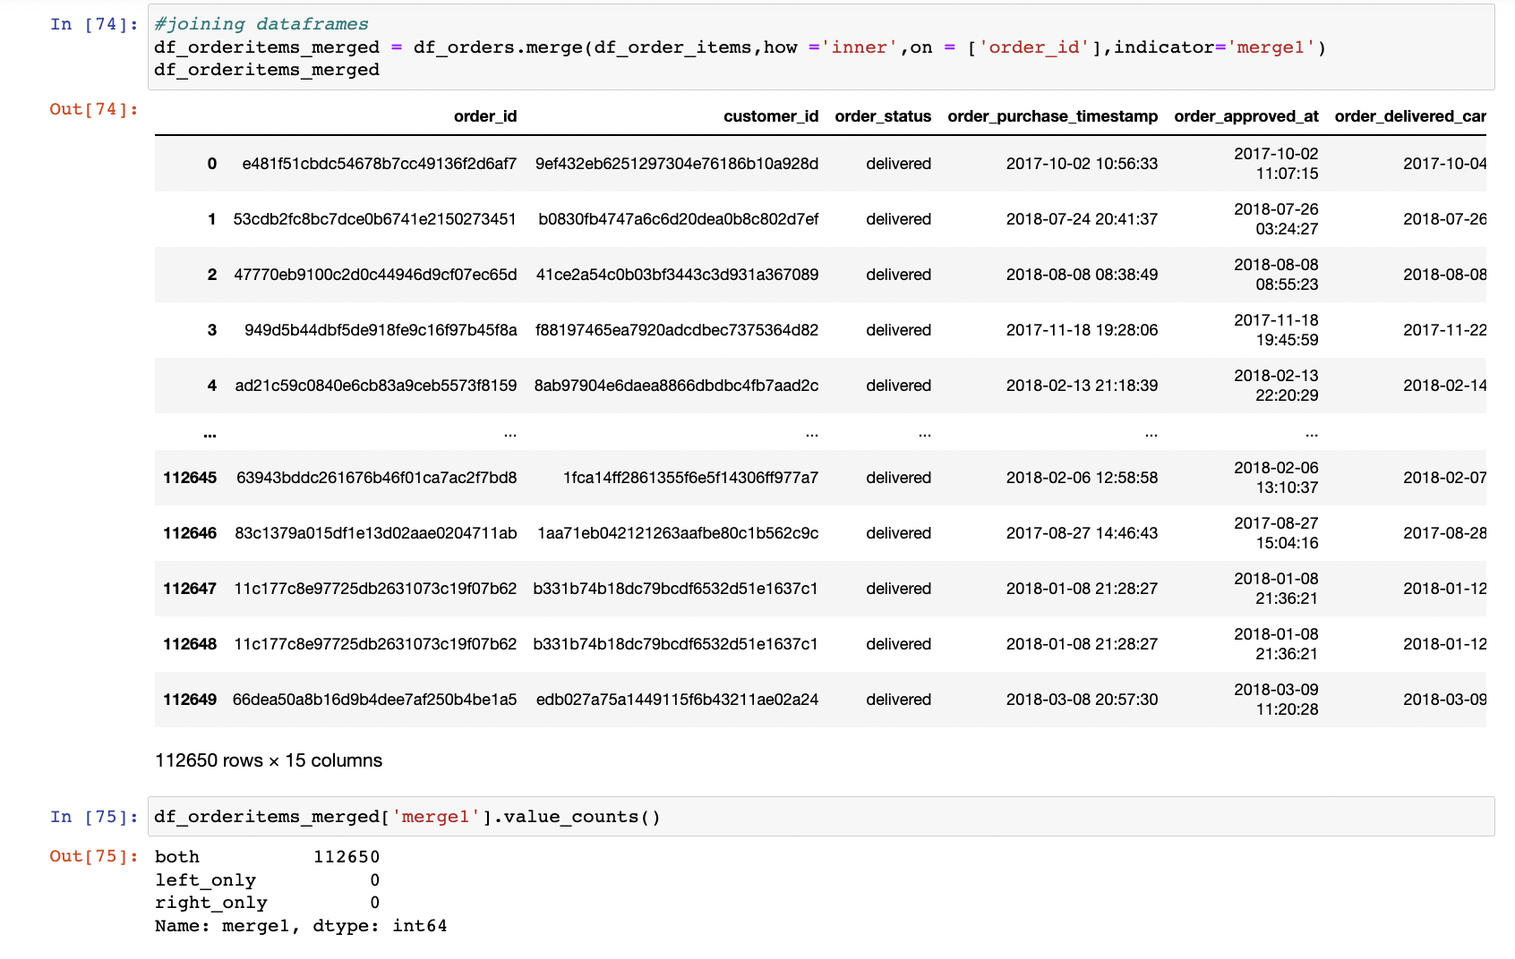
ETL cont.

Slide 11
What is the yearly trend of customer purchases?
What are the average order values of customers?
What are the top 5 cities with the highest customer revenue from 2016 to 2018?
What are the delivery success rates across different states?
What are the preferred forms of payments for different categories?
Business Questions

Slide 12
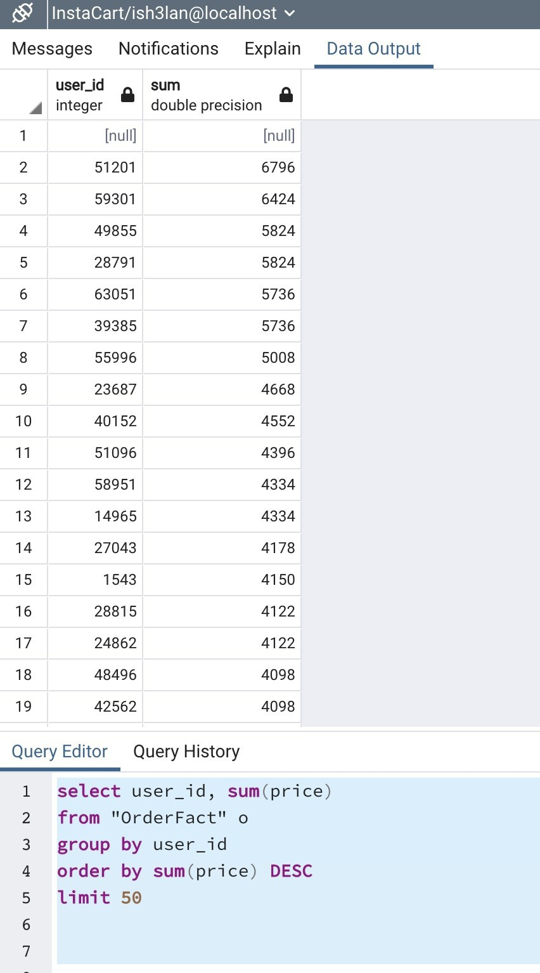
Business Question- Query
Who are the top 50 spenders?

Slide 13
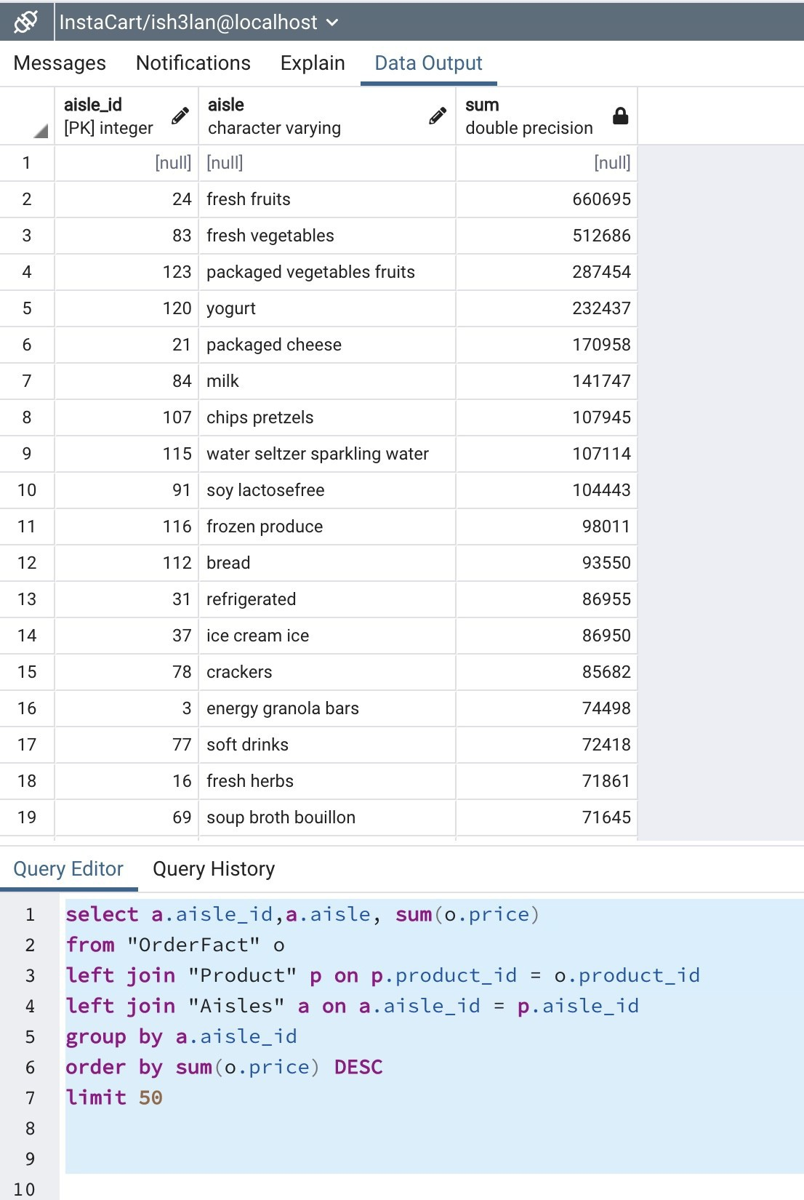
Business Question – Query Cont.
Which aisle generated the most sales?

Slide 14



Visualization

Slide 15
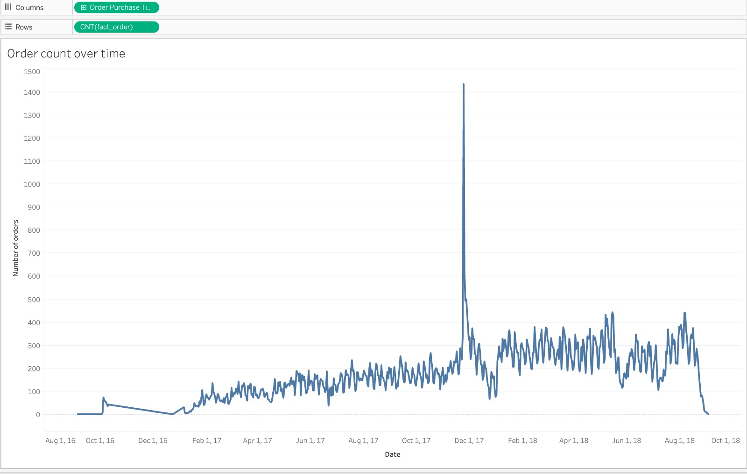
Visualization 1
Order count over time

Slide 16
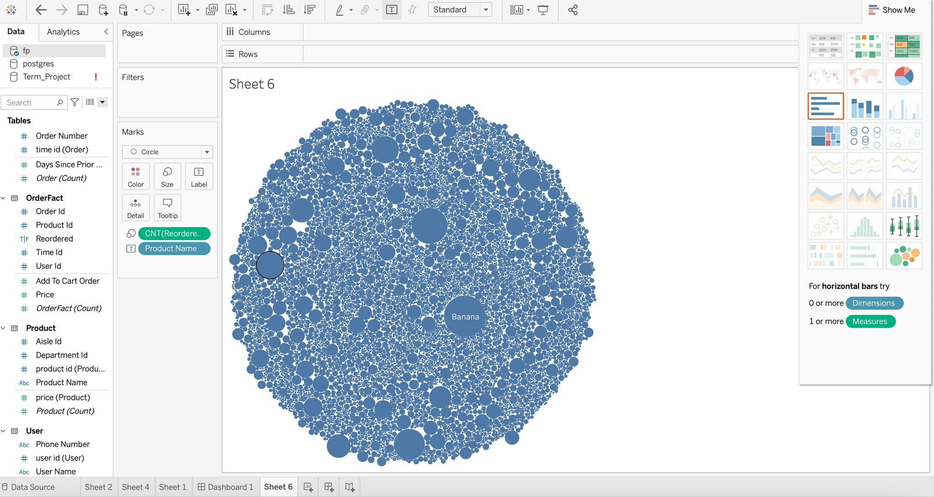
Visualization 2
What are the most reordered products?

Slide 17
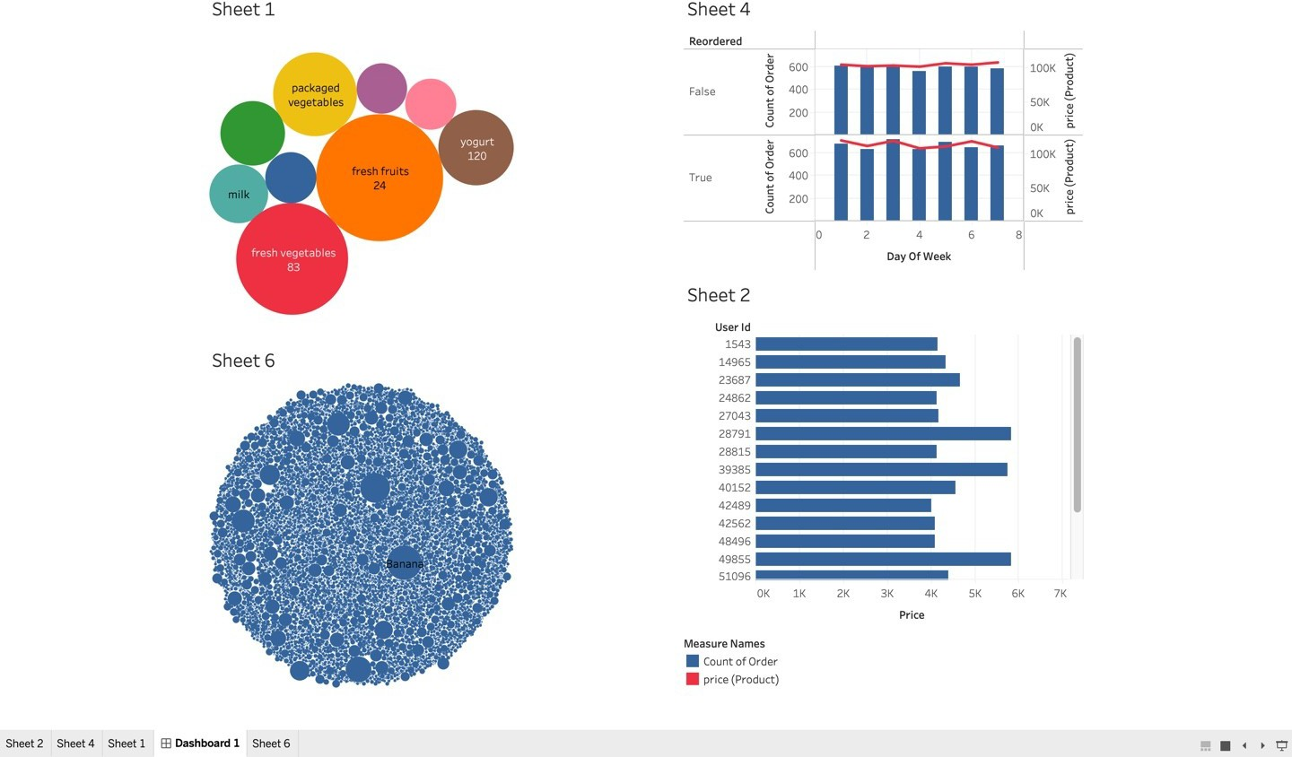
Dashboard

Slide 18



Future Work – what we
Implement prediction models
would do with more time and resources
Consolidate more data sources
Use different ETL tools like informatica…

Slide 19

Thank you!

